Slide 1

Electric Vehicle Market Analysis Dashboard
A Data Analytics Project using Power BI
Focus: EV adoption trends, market share, pricing patterns, and policy insights

Slide 2

Introduction to Electric Vehicles
Electric Vehicles (EVs) run on electricity instead of petrol or diesel
Use electric motors powered by rechargeable batteries
Help reduce air pollution and carbon emissions
Important for sustainable transportation
Types of Electric Vehicles:
Battery Electric Vehicles (BEV): Run completely on electricity
Plug‑in Hybrid Electric Vehicles (PHEV): Use both electricity and fuel

Slide 3
Introduction
The dashboard summarizes rapid growth in electric mobility and shifts toward sustainable transport, highlighting key patterns in adoption, pricing, and geography.
It enables data-driven decisions for stakeholders and policymakers via clear visual analytics and actionable metrics.

Slide 4

Project Objectives
* Analyse the growth of electric vehicle adoption. * Identify leading EV manufacturers and popular models. * Study the relationship between vehicle range and price. * Understand the geographic distribution of EV’s * Analyse Clean Alternative Fuel Vehicle (CAFV) eligibility and policy impact.

Slide 5
Dataset Description
EV population dataset.
Variables include Model Year, Make, Model, EV Type, Electric Range, Base MSRP, and City.
Data cleaned and transformed before visualization.

Slide 6
Tools Used
Power BI for dashboard creation and visualization.
Power Query for data cleaning.
Interactive visuals such as KPI’s, bar charts, scatter plots, maps, and donuts charts.

Slide 7
Dashboard Visualizations
EV adoption trend
Leading EV Manufacturers
Most Popular EV models
Range vs Price Analysis
EV Distribution Map
CAFV Eligibility Distribution

Slide 8

Regional Distribution
EV market concentration varies: Asia-Pacific and Europe lead adoption, North America expanding steadily.
Urban centers show higher penetration; emerging markets grow via targeted incentives and fleet electrification. Market share differs by policy, infrastructure, and consumer incentives.

Slide 9
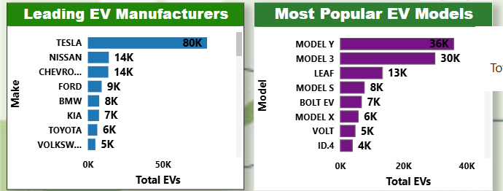
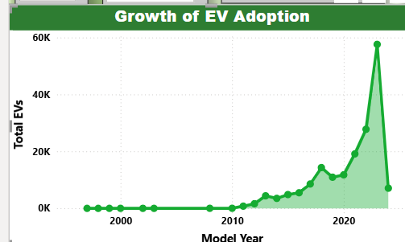

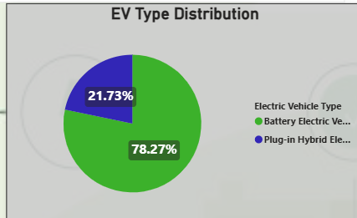
Data Insights

Slide 10

Rapid growth in EV adoption over recent years.
Market dominated by a few major manufacturers.
Higher battery range often corresponds with a higher price.
Fully electric vehicles are gaining popularity.
Government incentives influence EV adoption.

Slide 11
Future Scope
Include real-time EV sales data.
Apply Machine Learning to predict EV adoption trends.
Analyze charging infrastructure availability.
Include consumer demographic insights.

Slide 12

Conclusions
The EV market is rapidly expanding, led by policy-driven regions and falling battery costs.
Data-driven dashboards enable stakeholders to monitor adoption, optimize pricing strategies, and prioritize infrastructure investments for sustained growth. Actionable insights guide next steps.

Slide 13
THANK YOU!
GLENITA DSOUZA dsouzaglenita2002@gmail.com

